Slide 1

Patching Automation
Steven Sanders

Slide 2


Technologies Leveraged and Design Topics
SCCM
Nessus
Powershell
Or
Workflow
Python

Slide 3




The Vision
SCCM
Python
Powershell
Nessus
Monthly Patching is Automated and Engineers have to monitor, report, and remediate with a focus on getting as close as possible to compliance.

Slide 4
Design Topics
What do we want to automate?
*This model is just for monthly patching. Catching up on old patches will have to be a separate model
SCCM
What do we want to automate?
Server Monthly Patching
Remediation Patching
Packaging and downloading Updates
Nessus Scans
Deploying to Pilots and Production
Pull Data From Scans
Create SUGs and Collections
Deployments

Slide 5

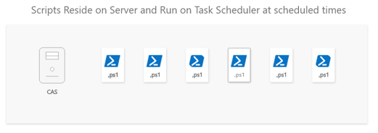
Design Topics
How do we automate monthly?
SCCM
What do we want to automate?
We have [X] Collections With Maintenance Windows for week 3
We automate monthly software update group creation leveraging ADRs and scripting
We script deployments to these collections
Script Reside on CAS and run on Task Scheduler
We have custom reports built for this or use the default reports with subscription models
Monthly

Slide 6
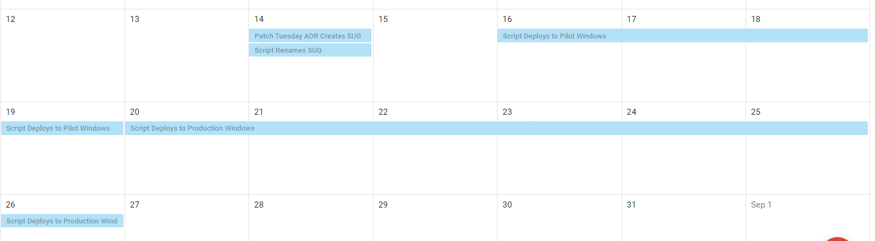
Design Topics
Monthly Workflow and Calendar
SCCM
What do we want to automate?
Monthly
Workflow
Patch Tuesday the ADR Creates the SUG
Script Renames SUG
Scripts Deploy Monthly Patches to Pilot on the same week as Patch Tuesday
Scripts Deploy Monthly Patches to Production the week after
Engineering monitors and reports

Slide 7
Design Topics
Remediation
SCCM
Tasks to Automate
What do we want to automate?
Scheduled Nessus Scans on specific machine groups
Scheduled Script to Pull Reports as csv
Scheduled Script to assign hostname to ip addresses via DNS (The IPs should be static for server)
Script to create collections of the converted machine names.
Script to create SUG from missing patches
Script to create Deployment
Monthly
Remediation
Python
Powershell

Slide 8
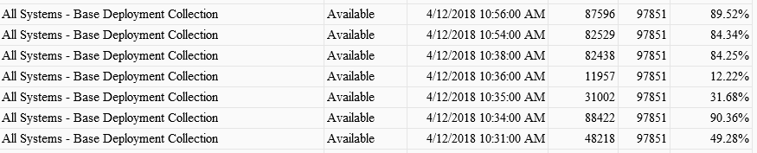
Reporting
This subscription report will look similar to this
This is just for example only (We wouldn’t deploy to “All Systems”)

Slide 9
Reporting
Data Analytics Enhancements
We can use PowerBI or Tableau to create enhanced reporting straight from the SCCM Database over Deployments.
It’s not necessary but you can do a lot of interesting things to drill down on reports
SCCM’s default SSRS Reports are sufficient for the reporting we want

